Slide 1
Module 6: Making Remote Calls
SER 423

Slide 2
Getting Data

Slide 3
Making a GET Request
As discussed before, if we want to get data from a remote source, we will need to make a GET request for it
We build the request using the fetch function built into Javascript
This takes two parameters:
  First is the URL you are fetching from
  The second is an optional object which will allow us to set a number of parameters for the request
There are a lot of possible options to specify in that object, but most of the time the default will work
Options of interest are:
  headers - this is itself a list of suboptions that the call might require
  body - the actual content being sent, this will usually hold your results in the response
The option that is probably most important is the method option
  GET, POST, etc.

Slide 4
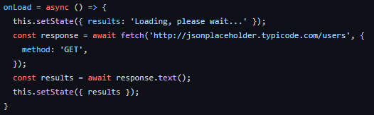
Example GET Request

Slide 5
Working with the Response Object
The response object you get back is the result from the remote server you made your call to
There are several pieces of information within it that you might want depending on your situation
Response.status - This is the code for the response (ie. 200 for success)
Response.ok - This boolean is true if the status is a success code (200 - 299)
  Be sure to check this before doing anything with the response!
Response.text - The body of the response in a text representation
  You can access the body directly, but it is a readable stream in that form
Response.json - The body parsed as JSON

Slide 6
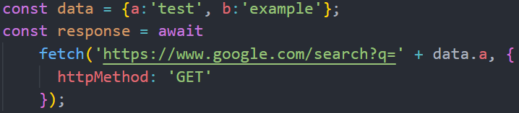
Adding Parameters to the Call
As discussed last time, you might add query (or other) parameters to your request
You can do this by adding a parameter to your request called params
  This is covered more in a minute when we look at POST requests
You can also append the parameter directly as a string onto the URL

Slide 7
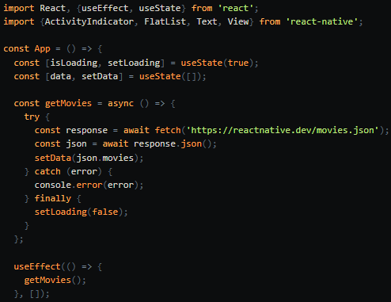
Another Example

Slide 8
Warning - HTTP VS HTTPS
Both Android and iOS now block cleartext URLS
  Cleartext being those that begin with HTTP and not HTTPS
iOS has a system called App Transport Security (ATS) which is what blocks the calls
  You can provide a whitelist of cleartext URLs if you know them ahead of time
  You can also disable ATS altogether - but if you want to put it on the Apple store, Apple requires a reasonable justification for disabling it
Android does not give a formal name to this system, but you can enable cleartext URLs if you need
  Add android:usesCleartextTraffic to your manifest file.
At the end of the day - most websites use HTTPS now so it should not be much of an issue
  But we wanted to point this out here just in case you end up running into it on your own

Slide 9
Making a POST Request

Slide 10
Building the POST Call
You can use fetch again for this
However, there is a package called axios that is very popular for managing remote calls
You build your request like you did with a GET request
A key difference though is that now you must provide the data to be POSTed
First, add a header and within the header add a parameter for the content-type
  ie. application/json
Then, outside the header, add a params parameter, which itself lists the data you want to POST
You can then post this either with fetch or axios as the book does

Slide 11
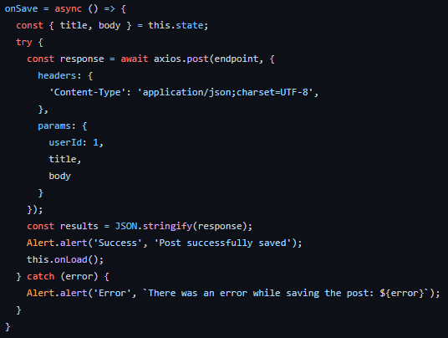
Making the POST Call

Slide 12
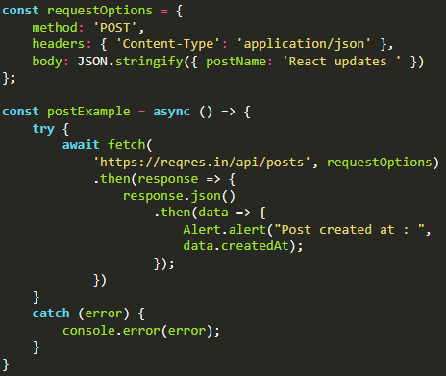
Another POST Example

Slide 13
End of Making Remote Calls
That’s all for Module 6

